Slide 1

AXIS BANK QUALITY ASSURANCE PROGRAM - 2024 CAPSTONE PROJECT
UNDER THE GUIDANCE OF : Mr. C.K. NAVEEN
GROUP 7
BY :
KANDADI VISHNU VARDHAN
MEDA VEERENDRA CHARAN TEJ
POORNACHANDRA SWAMI
KETHAVATH BHAVYA
VAIBHAV TANDALE

Slide 2

TABLE OF CONTENTS
INTRODUCTION
PROJECT OVERVIEW
CASE STUDY - 1
CASE STUDY - 2
CASE STUDY - 3
CASE STUDY - 4
CONCLUSION

Slide 3

INTRODUCTION
QUALITY ANALYST
QA Analyst is responsible for testing software applications to ensure they meet quality standards and functional requirements.
They design test plans, execute test cases, and report any defects found during the testing process.
Collaborating with developers and stakeholders, QA Analysts contribute to the delivery of high-quality software products through continuous testing and improvement efforts.

Slide 4







TOOLS AND APPLICATIONS USED
Selenium
Java
Eclipse
Chrome driver
SQL Server
Microsoft Excel
GitHub

Slide 5

CASE STUDY - 1
SELENIUM
Selenium is an open-source automation testing tool used for web applications. It allows testers to automate web browsers, simulating user interactions to test website functionality.
Selenium supports multiple programming languages, browsers, and platforms, making it a widely-used tool in the testing industry
Enables fast and efficient testing, reducing testing time and improving overall quality of web applications.

Slide 6

CASE STUDY - 1
Automate the steps of the website through selenium with JAVA.
https://testautomationpractice.blogspot.com/
1. Launch the website.
2. Enter name.
3. Print the value of name.
4. Enter email address.
5. Print the value of email address.
6. Enter the phone number.
7. Print the value of the phone number.
8. Clear the name and enter the new name.
9. Clear the phone number and enter the new phone number.
10. Select the gender.
11. Select the Days.

Slide 7
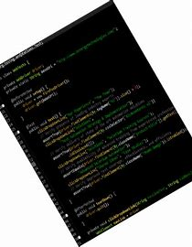
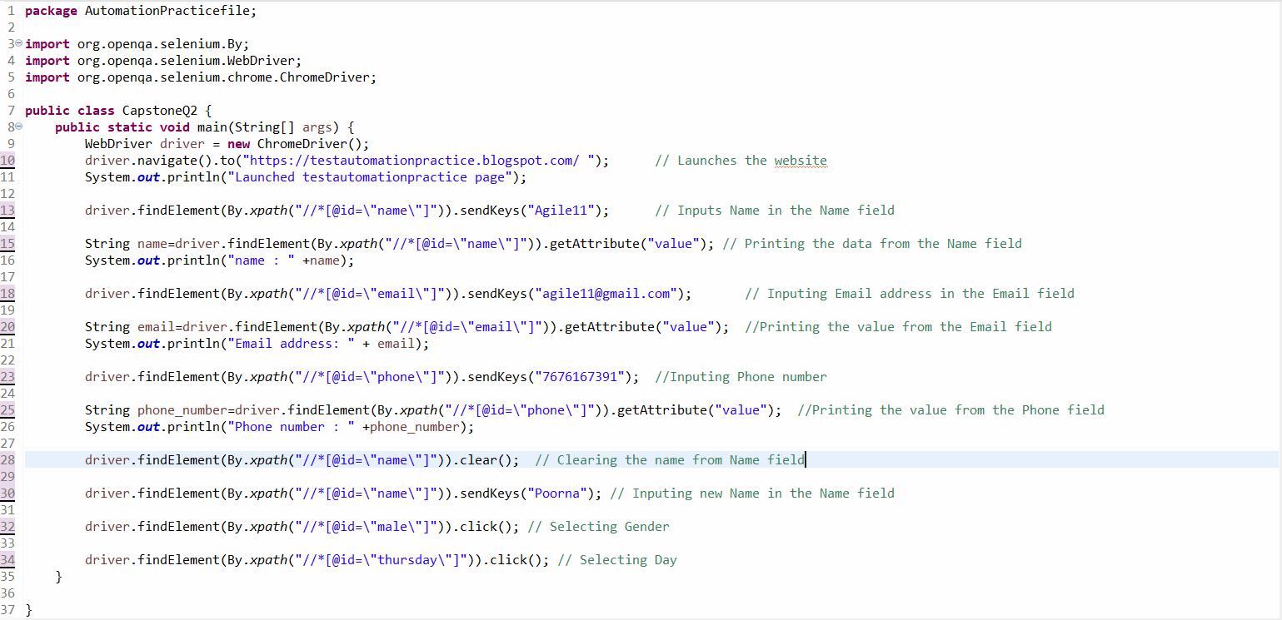
CASE STUDY - 1
Selenium code for Automation 🐞

Slide 8


CASE STUDY - 2
Automate the steps for creating an gmail new account through selenium with JAVA.
https://accounts.google.com/lifecycle/steps/signup/name?continue=https://mail.google.com/mail/&ddm=1&dsh=S-402560169:1730162659844053&ec=GAlAFw&flowEntry=SignUp&flowName=GlifWebSignIn&hl=en&service=mail&TL=AKOx4s0cLXVBwKEEOpnZZWOQISHz1jO7fz_V8QnNVsux1gUhie2XceXflicmMMjZ
1. Enter the name.
2. Get the print of the name.
3. Enter the last name.
4. Click on the next button.
5. Give timeout(thread.sleep).
6. select the month.
7. Enter the day.
8. Enter the year.
9. Select gender.
10. Click on the next button.

Slide 9
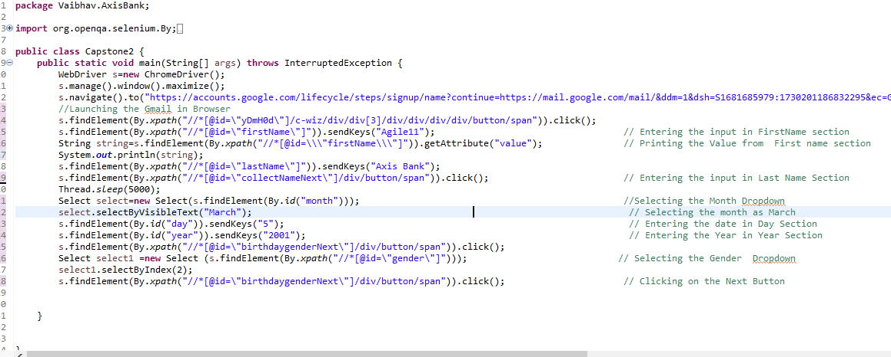
CASE STUDY - 2
Selenium code for Automation 👀

Slide 10

CASE STUDY - 3
Create an SQL table for AxisBank_customer and perform below activities:
1. Add the below mentioned attribute and add records for 20 customers: customer_id, customerName, credit_limit, applicable, cvv, expiry_date, kyc_status.
2. Write the query below: Get all data for the customer which has KYC status verified?
3. Calculate the balance who is done with KYC.
4. What is the average Balance limit for state (particular) state from the table?
5. Display the name of a customer who has a credit_limit more than 45000.
6. Display name of customer, who has expiry date after 2025 and having credit limit > 50000.

Slide 11
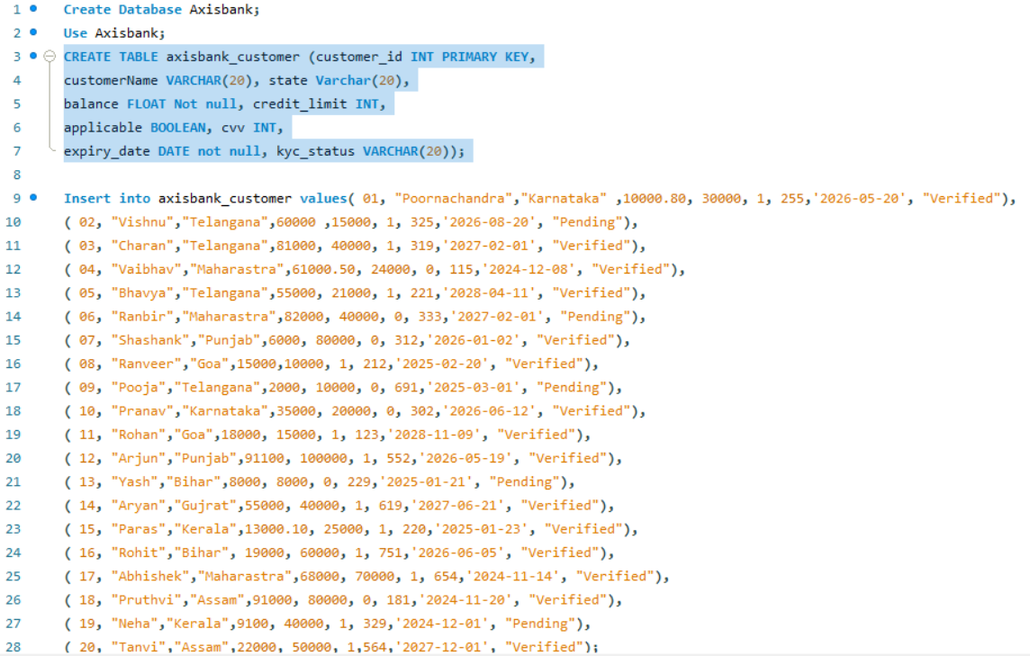
QUERY OF SQL
1. Add the below mentioned attribute and add records for 20 customers: customer_id, customerName, credit_limit, applicable, cvv, expiry_date, kyc_status.

Slide 12
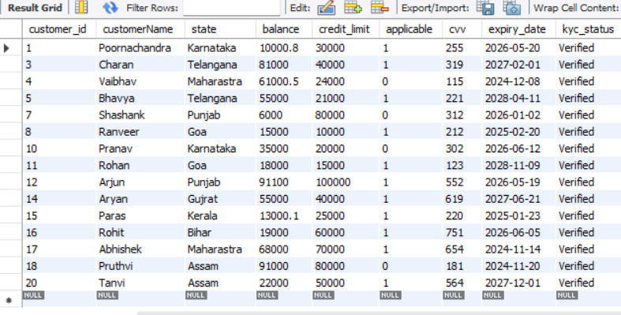
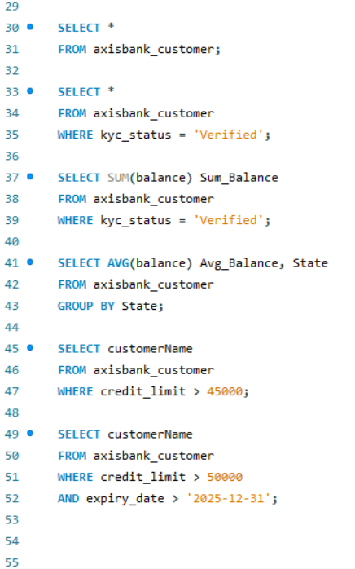

QUERY OF SQL
2. Write the query below: Get all data for the customer which has KYC status verified?
3. Calculate the balance who is done with KYC.

Slide 13
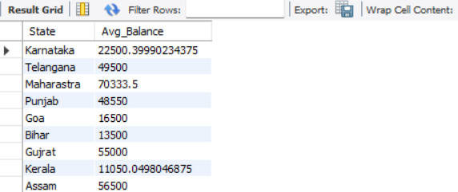
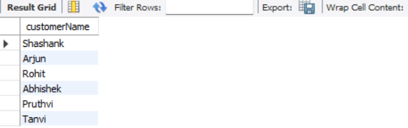
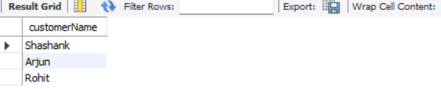
QUERY OF SQL
4. What is the average Balance limit for state (particular) state from the table?
5. Display the name of a customer who has a credit_limit more than 45000.
6. Display name of customer, who has expiry date after 2025 and having credit limit > 50000.

Slide 14

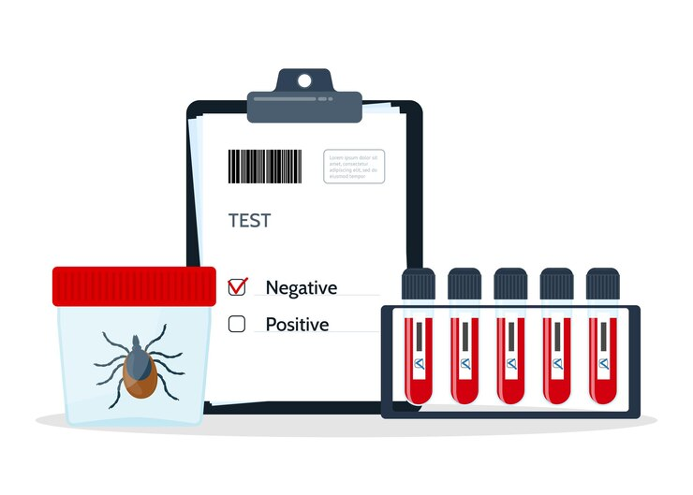
CASE STUDY - 4
Participants need to check on below and write the test cases for below scenarios:
1.Launch the below website:
https://www.goindigo.in/?utm_source=google&utm_medium=cpc&utm_campaign=search_campaign_6exclusivefare&cid=Search|Brand|P|6ExclusiveFare|21Sept&s_kwcid=AL!12293!3!714366880494!b!!g!!goindigo&gad_source=1&gclid=Cj0KCQjwmt24BhDPARIsAJFYKk2fVJfIcTkoN3kx_-po4_t6CrtUKtl_vFBJJD4hd9fZjfeI6UrMfhIaApOtEALw_wcB
2. Write the detailed test case for "Round Trip" Booking.
3. Need test case in proper test case format.

Slide 15
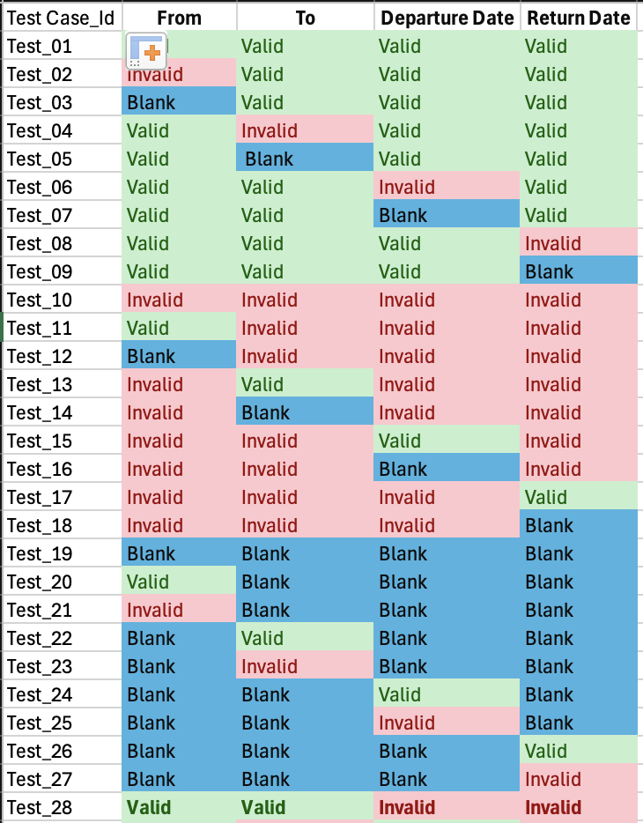
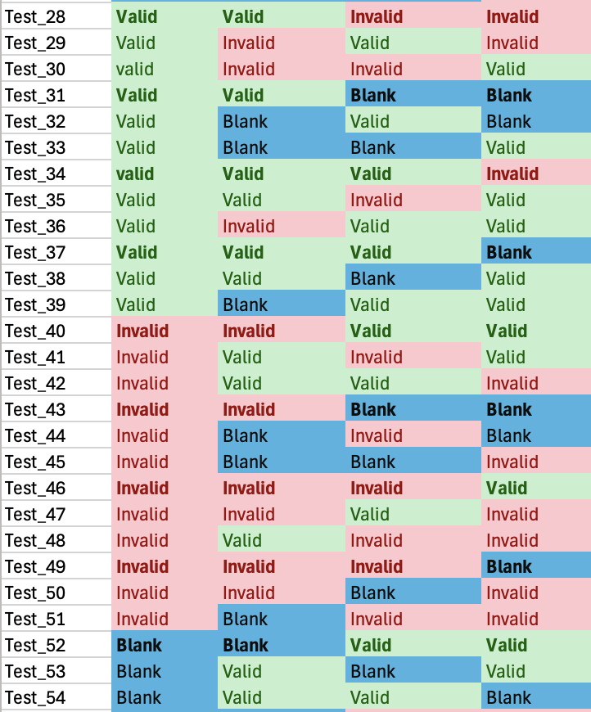
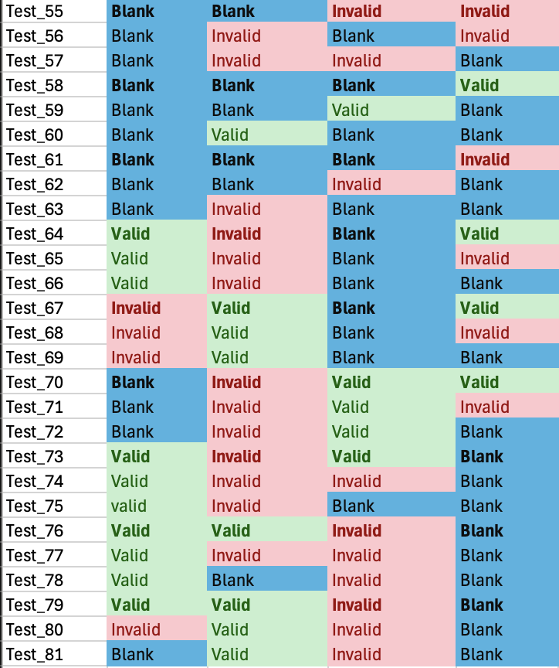
CASE STUDY - 4
TEST CASES FOR INDIGO ROUND TRIP

Slide 16
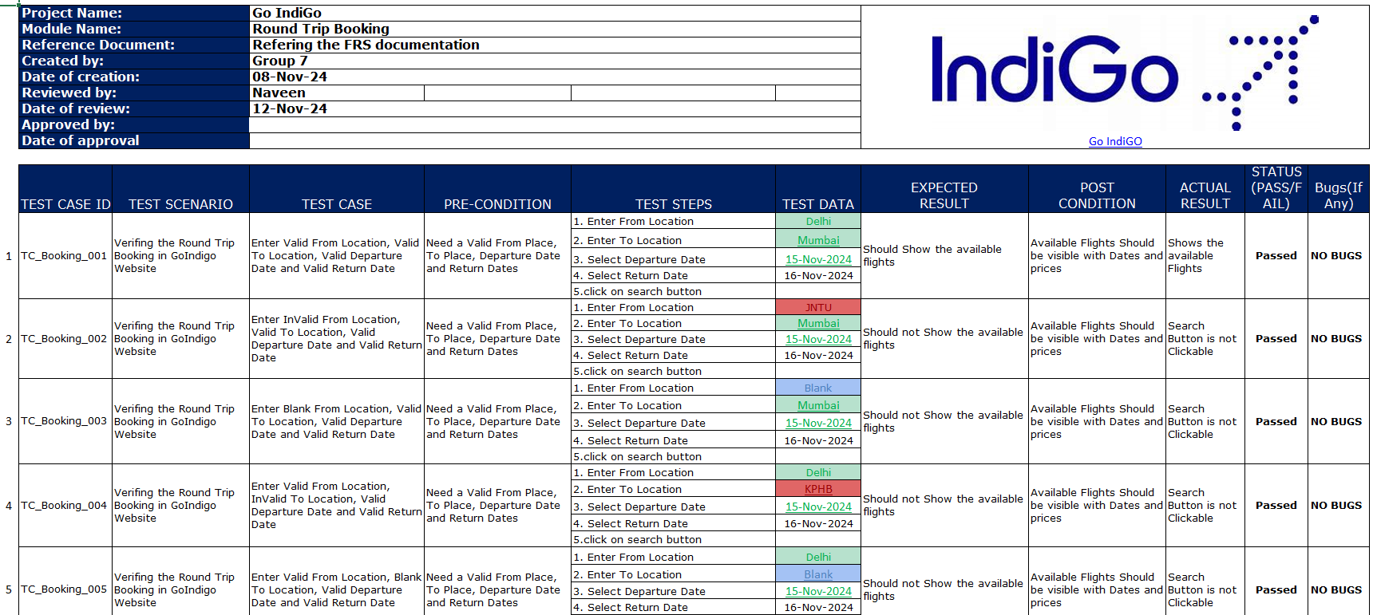
PROPER TEST CASE FORMAT

Slide 17

CONCLUSION 💡
Selenium Automation:
Automated key workflows through Selenium with Java to improve efficiency and accuracy.
Reduced manual testing time by automating repetitive tasks in Gmail Registration page and automated the given practice website.
SQL Project:
Designed and optimized SQL queries for efficient data management and retrieval.
Enhanced database performance and data integrity with advanced querying techniques.
Test Case Development for Indigo Round Trip:
Developed comprehensive test cases to validate round-trip booking functionality.
Ensured test coverage and reliability, improving overall software quality.
GitHub Repository : https://github.com/PoornachandraSwami/Group7_CapstoneProject.git

Slide 18
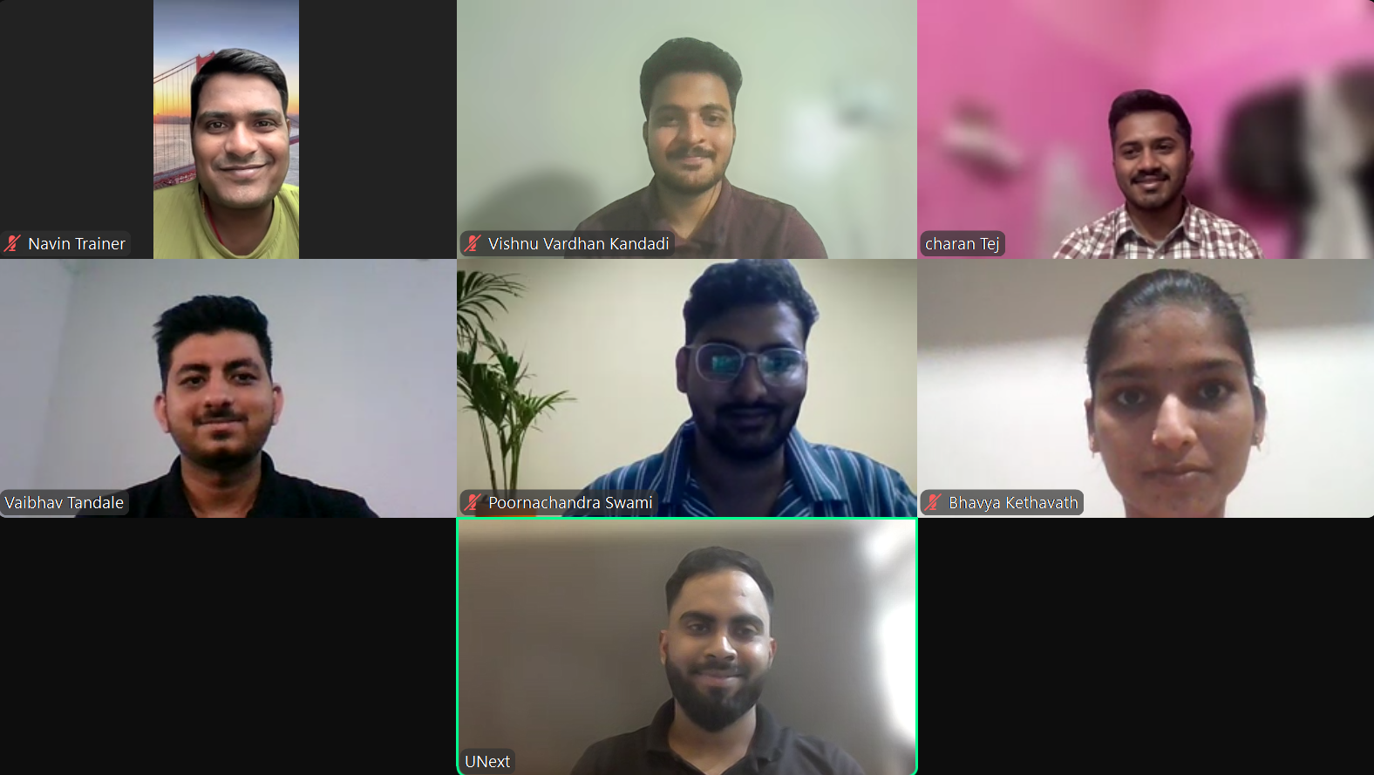
TEAM

Slide 19

GitHub Repository Link
https://github.com/PoornachandraSwami/Group7_CapstoneProject.git

Slide 20


Slide 21


